Slide 1




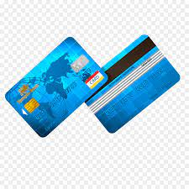

Provide Insights to the Product Strategy Team in the Banking Domain
RANJEEV PANDEY

Slide 2
Table of Contents
1
1. Introduction
2. Insights Ideas from Tony
3. Tools Used
4. Dashboard Overview
i) Demographic
ii) Avg_income_utilization
iii) Spending Insights
iv) Key Customer Segments
5. Credit Card Feature Recommendations
6. Additional Thoughts

Slide 3

Introduction
Mitron Bank is a legacy financial institution headquartered in Hyderabad. They want to introduce a new line of credit cards, aiming to broaden its product offerings and reach in the financial market.
AtliQ Data Services came to know about this through an internal link and approached Mitron Bank with a proposal to implement this project. However, the strategy director of Mitron Bank, Mr.Bashnir Rover is skeptical and asked them to do a pilot project with the sample data before handing them the full project.
They provided a sample dataset of 4000 customers across five cities on their online spend and other details.
Peter Pandey is a data analyst at AtliQ Data Services and was asked by his manager to take over this project. His role is to analyze the provided sample data and report key findings to the strategy team of Mitron Bank.
This analysis is expected to guide them in tailoring the credit cards to customer needs and market trends.
The successful acquisition of this project depends on Peter’s ability to provide actionable, data-driven recommendations and impress Mr. Bashnir Rover and his team.
Peter requested support from his manager Tony Sharma, and he provided him with some ideas to generate insights based on the data
provided.

Slide 4
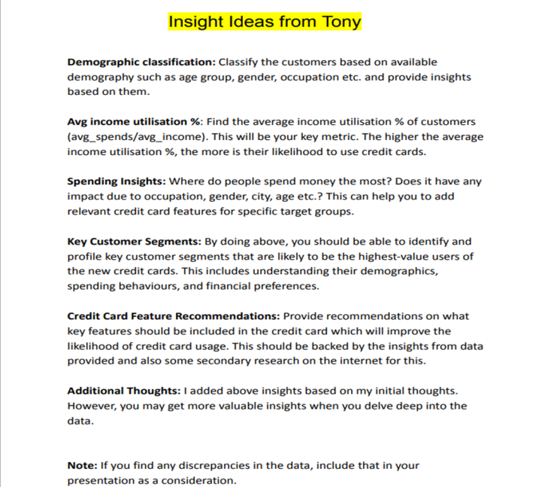
Insights Ideas from Tony

Slide 5



Tools Used
MS-Excel
2.Power BI
3.MS-PowerPoint

Slide 6
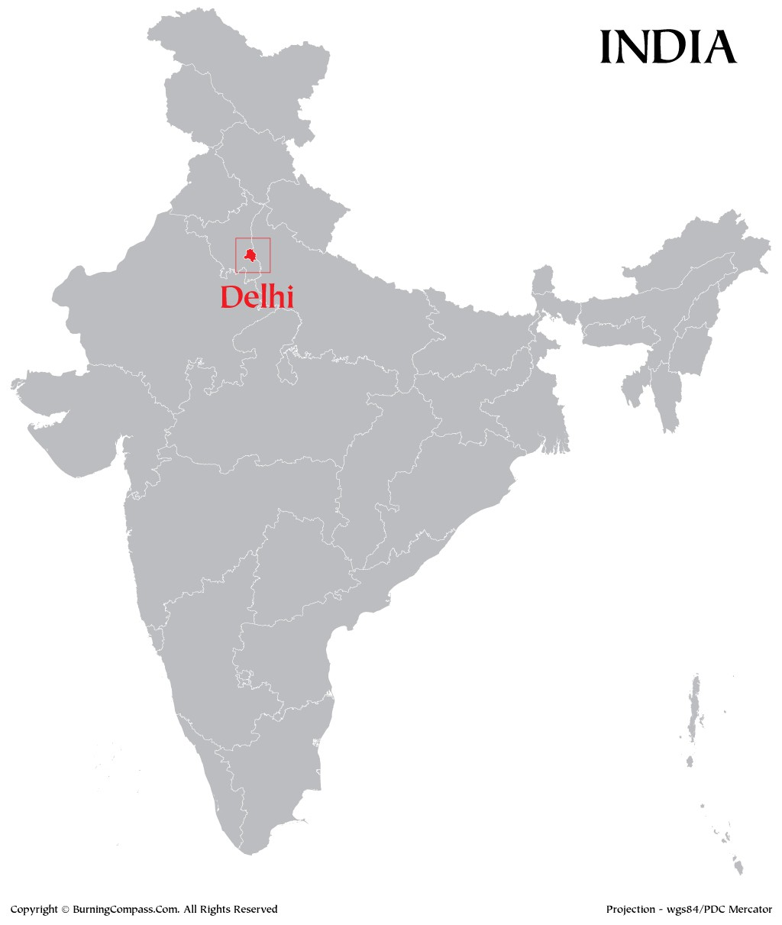

Demographic classification
I have classified the customer based on available demographics such as age group, gender, occupation etc . and provided insights into them.
,

Slide 7



4000 2597 1403
Total Customers Male Customers Female Customers
city |  |  | gender |  |  | age_group |  |  | marital status
All |  |  | All |  |  | All |  |  | All | 
Most number of accounts in the bank are of Salaried IT employees followed by salaried other employees
Mumbai city has the biggest number of customers. followed by Chennai
Most of our customers are married.
Most of our customers are in the age group of 25-34. Followed by the age group of 35-45.
Very few of our customers are government employees.
We have the lowest number of customers in Hyderabad.
customers by marital status
Count of customer_id by occupation
864 (21.6%)
1294
893
784
630
marital status
Married
Single
399
3136
(78.4%)
Salaried IT E…
Salaried Othe…
Freelancers
Business Own…
Government …
occupation
customers by city
customers by age_group
Mumbai
1078
1498
1273
Chennai
834
Bengaluru
751
691
538
Delhi NCR
744
Hyderabad
593
25-34
35-45
21-24
45+
age_group

Slide 8

Avg income utilisation %
Find the average income utilisation % of customers (avg_spends/avg_income). This will be your key metric. The higher the average income utilisation %, the more their likelihood of using credit cards.

Slide 9
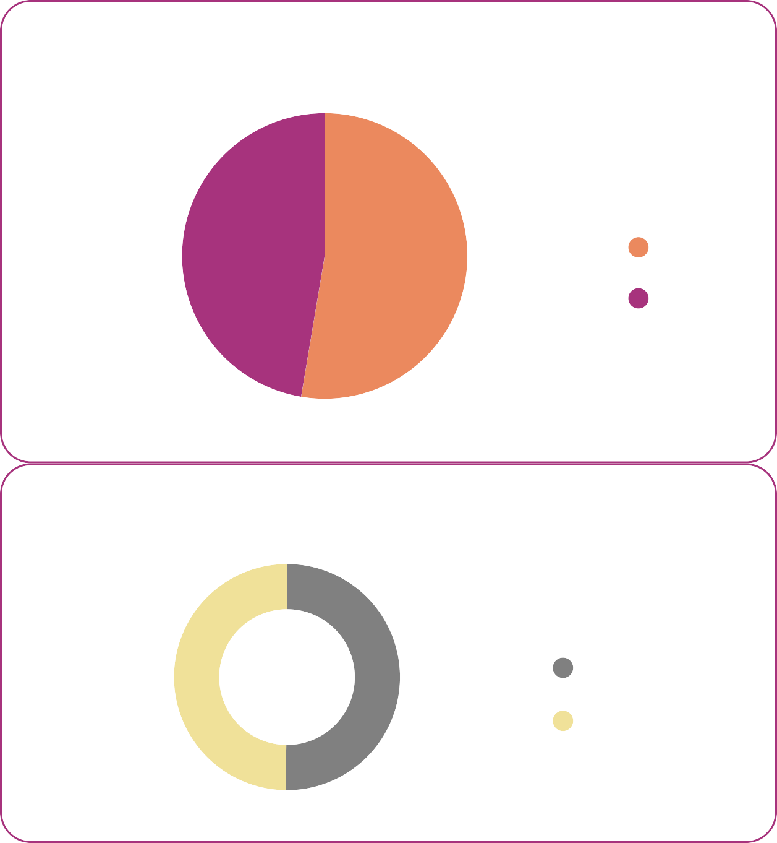
city
gender
age_group
marital status
$207M $51.66K 42.82%
Total Income avg income Avg Income Utilization %
All

All

All

All

Income Utilization % by category
Income Utilization % by gender Income Utilization % by age_group
8.46%
39.92%
(47.35%)
gender
Male
46.72%
6.96%
35-45
6.42%
5.29%
Female
4.78%
44.39%
(52.65%)
25-34
43.66%
3.55%
3.33%
2.75%
Income Utilization % by marital status
1.29%
21-24
40.59%
42.77%
(49.83%)
marital status
Single
Married
Bills
Groceries
Electronics
Travel
Food
Apparel
Others
45+
34.70%
Health & Wellness
Entertainment
43.06%
(50.17%)
occupation
Avrg_Income

Income Utilization %
Income Utilization % by month
Income Utilization % by city
Business Owners | $70,091.17936507937 | 33.22%
Salaried IT Employees | $61,499.67310664606 | 51.04%
Government Employees | $52,034.83458646617 | 29.00%
Salaried Other Employees | $38,793.43673012318 | 42.10%
Freelancers | $35,058.25382653061 | 45.80%
8.14%
51.43%
48.03%
9.35%
6.94%
6.50%
43.46%
36.25%
6.40%
31.10%
5.50%
Total
$51,657.03225
42.82%
Septemb…
August
October
July
June
May
Mumbai
Delhi NCR
Bengaluru
Hyderabad
Chennai

Slide 10

Spending Insights
Where do people spend money the most? Does it have any impact due to occupation, gender, city, age, etc.? This can help you to add relevant credit card features for specific target groups.

Slide 11
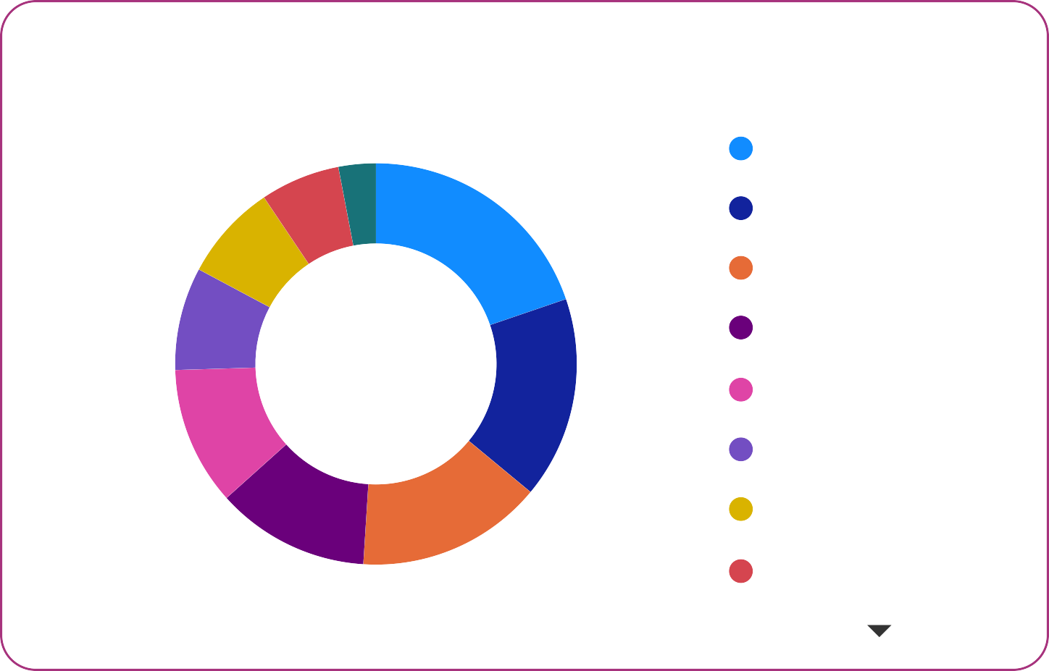




$429M
Total Spend by Marrieds
$531M $88.48M $357M
Total Spend Avg_Spend Total Spend by Male
$174M
Total Spend by Female
$102M
Total Spend by Singles
Total Spend by occupation
Total Spend by age_group
Total Spend by city
$244M
25-34
$203M
$172M
35-45
$191M
$111M
$88M
$88M
$100M
$76M
$80M
$68M
$36M
21-24
$69M
Salaried IT Employees
Business Owners
Salaried Other Employees
Freelancers
Governm… Employees
45+
$68M
Mumbai
Delhi NCR
Bengaluru
Chennai
Hyderabad
Total Spend by payment_type
Total Spend by category
category
Total Spend by month
$54M (10.21%)
$16M
$105M (19.76%)
Bills Groceries Electronics
Health & Welln… Travel
Food
Entertainment Apparel
$216M
(40.74%)
$41M (7.78%)
$44M (8.29%)
(3.01%)
$120M (22.52%)
payment_type
Credit Card
UPI
Debit Card Net Banking
$116M
$101M
$86M
(16.26…)
$86M
$81M
$79M
$59M (11.16%)
$68M
September
August
October
July
June
May
$141M (26.53%)
$66M (12.36%)
$80M (14.99%)

Slide 12





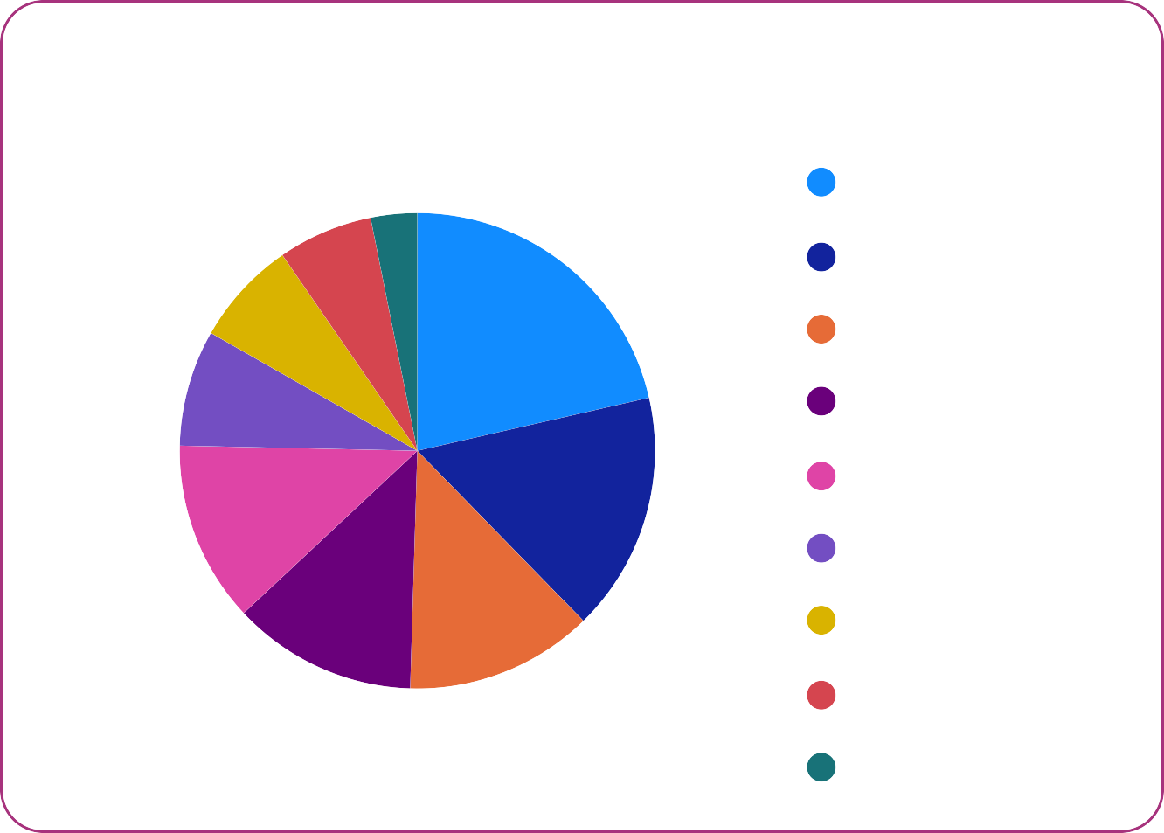
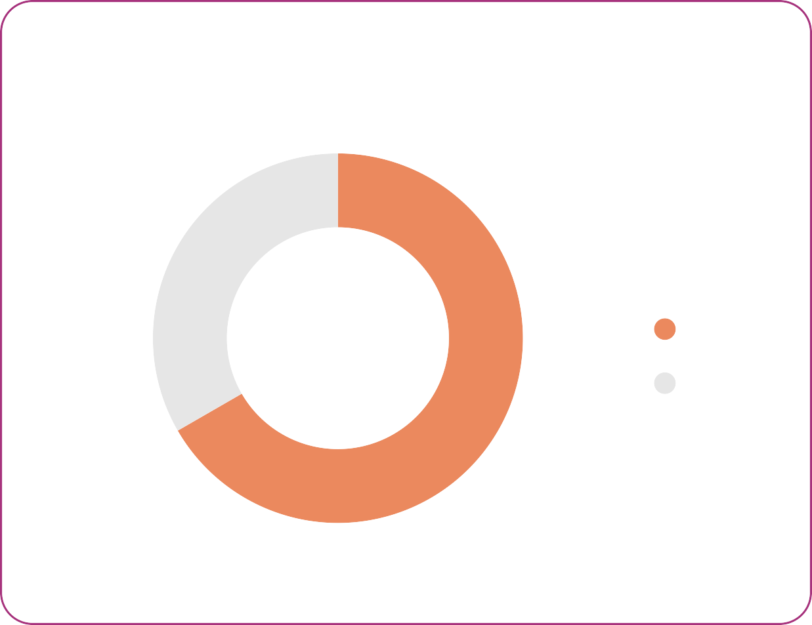
$531M
Total Spend
$216M
Total Spend by Credit Card
$141M
Total Spend by UPI
$120M
Total Spend by Debit Card
$54M
Total Spend by Net Banking
Total Spend by marital status
Amount Spent By Credit Cardby AgeGroup
Amount Spend by Credit Card marital status wise
$40M (18.5…)
$102M (19.19%)
25-34
$95M
marital status
Married
Single
35-45
$74M
marital status
Married
Single
45+
$24M
$429M
(80.81%)
21-24
$23M
$176M
(81.48%)
Credit Card Used by Category Spend
category
Amount Spend by Credit Card Occupation Wise
$101M
Amount Spend by Credit Card gender wise
$7M (3.16%)
$46M
(21.42%)
Bills Electronics
Health & Well…
Groceries Travel Entertainment Food
Apparel Others
$72M (33.34%)
$15M (7.13%)
$17M (7.9…)
gender
Male
Female
$37M
$36M
$26M
$35M
(16.2…)
$16M
$27M (12.3%)
$27M (12.56%)
$28M (12.79%)
Salaried IT Employees
Salaried Other Employees
Business Owners
Freelancers
Government Employees
$144M (66.66%)

Slide 13
Amount Spend by Credit Card Month Wise
$47.3M
$41.1M
$35.1M
$32.8M
$32.3M
$27.8M
May
September
August
October
July
June

Slide 14

Key Customer Segments
Most of the account holders in the bank are male(2597)
Most of the account holders in the bank are married(3136)
The Mumbai Branch of the bank has the highest number of customers.
The Hyderabad Branch of the bank has the least number of customers.
The biggest number of account holders are in the age group of 25-34 and the least age group is 45+.
Most of the account holders are salaried IT professionals and the least are government employees.
Average Income Utilization % is 42.82%.
Customers' income utilization is most on bills @8.46% followed by groceries @ 6.96 and least on others @1.29%.
Males & singles have higher income utilization.
The age group of 35-45 has the highest income utilization % @ 46.72 and the lowest income utilization % is of the age group having an age more than 45+ @34.70.
Salaried IT employees have the highest income utilization @51.04 % and least income utilization is of Government Employees @29.00%
September has having highest income utilization %.
Mumbai City has the highest income utilization.
Salaried IT employees & age group of 25-34 are the ones who spend the most. Mumbai city has highest amount spend.
Credit Cards the mostly used for the amount spent.
Most of the amount is spent on payment of bills.
September is the month where people are spending the most and September is the month where credit card is used most.
Most of the credit card users are age group 25-34 & salaried IT employees are the ones who spend most of their amount using credit cards.
Males and married are the ones who use credit cards for most of their spending.

Slide 15
Credit Card Feature Recommendations
Based on the insights derived from the provided data, here are some key features that could improve the likelihood of credit card usage:
Tailored Rewards for Bills and Groceries:
Since most customers' income utilization is on bills and groceries, a credit card offering enhanced rewards or cashback specifically for these categories could attract more usage.
Special Offers for Salaried IT Professionals:
Considering that salaried IT professionals have the highest income utilization, offering exclusive discounts, cashback, or rewards on tech-related purchases or services could be an attractive feature.
Targeted Rewards for the 25-34 Age Group:
Since this age group has the highest income utilization and credit card usage, customizing rewards and offers that align with their preferences, such as entertainment, dining, or travel benefits, could encourage more card usage.
Income Utilization Reports and Insights:
Providing detailed monthly reports on income utilization could help customers track and manage their spending effectively. This feature could include categorization of expenses and insights on optimizing their financial behavior.
September Promotions and Offers:
Capitalize on the trend that September has the highest income utilization by introducing special promotions, cashback, or rewards during this month to encourage increased credit card usage.
Geographically Tailored Benefits:
Given that Mumbai City has the highest income utilization, offering location-specific benefits, discounts, or partnerships with local businesses in Mumbai could attract more customers in that region.
Flexible Credit Limits:
Providing customizable credit limits based on the individual's income, spending habits, and repayment history can give customers more control over their finances and encourage them to use the credit card more frequently.
Security Features and Fraud Protection:
Emphasize robust security features, fraud protection, and easy reporting mechanisms to instill confidence in customers, addressing concerns related to credit card usage.
Educational Resources on Financial Management:
Offer resources or tools that help customers manage their finances better, including budgeting tips, expense tracking, and savings planning. This can build a long-term relationship and loyalty.
Collaborations with Popular Merchants:
Partnering with popular merchants for exclusive discounts, early access to sales, or special promotions for credit card users could incentivize customers to use the card for their purchases.

Slide 16
Additional Thoughts
Cultural Spending Preferences:
Understanding and aligning with cultural spending habits can be crucial. For example, festivals play a significant role in Indian culture, so offering special promotions, rewards, or discounts during festive seasons could boost credit card usage. September is the month in which Ganesh Utsav is celebrated in the whole of India.
Localized Language Support:
Providing customer support in regional languages can enhance accessibility and appeal to a wider audience, especially in areas where English may not be the primary language.
Tiered Rewards for Different Cities:
Since the Mumbai branch has the highest number of customers and income utilization, tailoring rewards or benefits specifically for customers in Mumbai could strengthen the card's popularity in that region.
Cashback on Utility Payments:
In India, utility payments, including electricity, water, and gas bills, are significant monthly expenses. Offering cashback or rewards for these essential services could encourage more users to opt for credit card payments.
Collaboration with Local Merchants:
Partnering with local businesses and merchants, especially those popular in different regions, can enhance the attractiveness of the credit card. This could include tie-ups with regional retailers, restaurants, or entertainment venues.
Education on Credit Card Usage:
In many parts of India, there might be a need for increased awareness and education about responsible credit card usage. Providing simple, easy-to-understand guides on how to use credit cards wisely could help in demystifying the process for potential users.
Flexible Payment Plans:
Offering flexible payment plans, especially for significant expenses like weddings or education, can make credit cards more appealing to a diverse range of customers with varying financial needs.
Government Employee Benefits:
Considering that government employees have the least income utilization, creating exclusive benefits or rewards for this segment could encourage higher credit card adoption among this group.

Slide 17
Additional Thoughts
Integration with Mobile Wallets:
Given the popularity of mobile wallets in India, integrating credit card features with popular mobile wallet services could attract users who are accustomed to using digital payment methods.
Digital Literacy Initiatives:
As digital literacy varies across demographics in India, implementing initiatives to enhance digital literacy and ease of online transactions can make credit cards more accessible and appealing, especially in rural areas.
Social Influence and Recommendations:
In India, word-of-mouth and recommendations from friends and family hold significant weight. Implementing referral programs or social sharing features that reward customers for bringing in new users could leverage this cultural aspect.
Thank You

